Slide 1
Statistical Reasoning
We have described several representations techniques that can be used to model belief systems in which a particular fact is
believed to be true,
believed to be false
or not considered to be either.

Slide 2
Statistical Reasoning
For some kinds of problem solving, it is useful to be able to describe beliefs that are not certain but for which there is some supporting evidence.
Two classes of such problems:
Problems in which there is genuine randomness in the world. Such as playing card games such as bridge. In these problems it is not possible to predict the world with certainty, some knowledge about the likelihood of various outcome is available, and we would like to be able to use it.

Slide 3
Statistical Reasoning
2. The second class contains problems in which the relevant world is not random, it behaves normally unless there is some kind of exception.
Many common sense tasks falls into this category, as do many expert reasoning tasks such as medical diagnosis. For problems like this statistical measures may serve a very useful functions.

Slide 4
Statistical Reasoning
Statistical measures serve a very useful function as summaries of the world;
Numerical summary that tells us how often an exception of some sort can be expected to occur.
We explore several techniques that can be used to augment knowledge representation techniques with statistical measures that describe levels of evidence and belief.

Slide 5
Statistical Reasoning
Probability & Bayes Theorem
An important goal for many problem solving systems is to collect evidence as the system goes along and to modify its behaviour on the basis of evidence
To model this behaviour we need a statistical theory of evidence. Bayesian statistics is such a theory.
The fundamental notion of Bayesian statistics is that of condition probability.

Slide 6
Statistical Reasoning
Probability & Bayes Theorem
Read the expression as the probability of Hypothesis H given that we have observed evidence E.
To compute this, we need to take into account the prior probability of H ( the probability that we would assign to H if we had no evidence) & the extent to which E provides evidence of H.
To do this we need to define a universe that contains an exhaustive, mutually exclusive set of Hi’s, among which we are trying to discriminate.
P(H\ E)

Slide 7
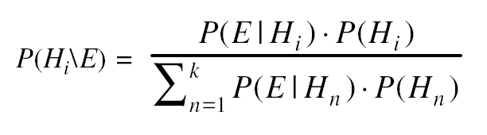
Statistical Reasoning
Probability & Bayes Theorem
P(H_{i}\ E) – the probability that hypothesis H_{i} is true given evidence E
P(E\H_{ii}) – The probability that we will observe evidence E given that hypothesis i is true
P(H_{i}) - The priori probability that hypothesis i is true in the absence of any specific evidence. These probabilities are called prior probabilities or priors.
K = the number of possible hypothesis.
Bayes’s theorem states that

Slide 8
Statistical Reasoning
Probability & Bayes Theorem
Mineral example – PROSPECTOR is a program which help in locating deposits of several minerals.
The key to use bayes’theorem as a basis for uncertain reasoning is to recognize exactly what it says.
When we say P(A\B), we are describing the conditional probability of A given that the only evidence we have is B.
If there is also other relevant evidence, then it must also be considered.
Spot, Fever & Measles Example

Slide 9
Statistical Reasoning
Probability & Bayes Theorem
The Baye’s theorem is intractable for several reasons:
The knowledge acquisition problem is insurmountable ; too many probabilities have to be provided. And there are substantial evidence that people are very bad probability estimators.
The space that would be required to store all probabilities is too large.
The time required to compute the probabilities is too large.

Slide 10
Statistical Reasoning
Even if we have the above mentioned problems the theorem is still very useful for the uncertain system. Various mechanisms to use it have been developed. Some of them are
Attaching certainty factors to rules
Bayesian Networks
Dempster-Shafer Theory

Slide 11
Statistical Reasoning
Certainty Factors & Rule Based Systems
In this we are trying to describe a practical way of compromising on a pure Bayesian System.
We will use MYCIN as an example here which uses LISP and acts as an Expert System.
MYCIN uses the rules to reason Backwards to the clinical data available from its goal of finding significant disease-causing organisms.
Each rules has a certainty attached to it. Once the identities of the organism is found, it then attempts to select a therapy by which the disease can be treated.

Slide 12
Statistical Reasoning
Certainty Factors & Rule Based Systems
A certainty factor(CF[h, e]) is defined in terms of two components:
MB[h, e] – a measure (between 0 and 1) of belief in hypothesis “h” given the evidence “ e”. MB measures the extend to which the evidence supports the hypothesis. It is zero if the evidence fails to support the hypothesis.
MD[h, e] – a measure (between 0 and 1 ) of disbelief in hypothesis “ h” given the evidence “e” . MD measure the extend to which the evidence supports the negation of the hypothesis. It is zero if the evidence support the hypothesis.
CF[h, e] = MB[h,e] – MD[h,e]

Slide 13
Statistical Reasoning
CertaintyFactors & Rule Based Systems
Since any particular piece of evidence either supports or denies a Hypothesis( but not both) and since each MYCIN rule corresponds to one piece of evidence ( can be compound piece of evidence) a single number suffices for each rule to define both MB and MD and thus the CF.
The CF’s are provided by the experts who write the rules. They reflect the experts assessments of the strength of the evidence in support of the Hypothesis.
At times CFs need to be combined to reflect the operations of multiple pieces of evidence and multiple rules applied to a problem.

Slide 14
Combining Uncertain Rules
191

Slide 15
Statistical Reasoning
CertaintyFactors & Rule Based Systems
The combining functions should satisfy the following properties :
Since the order in which evidence is collected is arbitrary, the combining functions should be commutative and associative.
Until certainty is reached, additional confirming evidence should increase MB and similarly for disconfirming evidence , MD.
By use of CFs we reduce the complexity of a Bayesian reasoning system by making some approximations to the formalism.

Slide 16
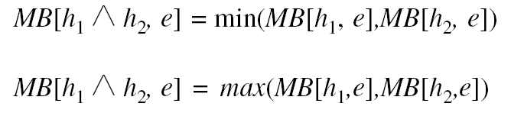
Combining Two Pieces of Evidence
Let MB’[h,s] be the measure of belief in h given that we are absolutely sure of validity of s. ‘let e be the evidence that led us to believe in s.

Slide 17
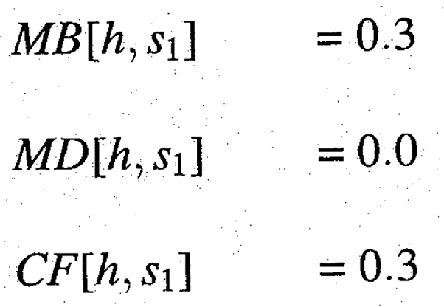
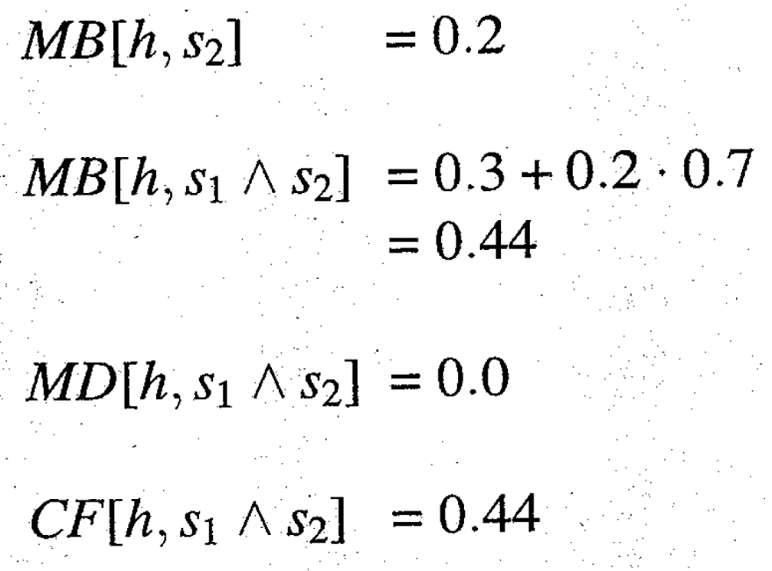
An Example of Combining Two Observations
Suppose we make an initial observation that confirms our belief in h with MB =0.3. Then MD(h,s₁)= 0and CFL, s₁]= 0.3. Now we make a second observation,
which also confirms h, with MB[h,s₂] =0.2.

Slide 18
Problem of Combining Two independent assumptions
let’s consider an example in which:
S:sprinkler was on last night
W: grass is wet
R:it rained last night
We can write rules that describe predictive relationships among these three events:
Rule1: if the sprinkler was on last night then there is suggestive evidence (0.9) that the grass will be wet this morning.
Rule 2: If the grass is wet this morning then there is suggestive evidence (0.8) that it rained last night.
If the two rules are applied together, we get
MB[W,S] = 0.8 {sprinkler suggest wet}
MB[R,W] = 0.8x0.9= 0.72 {wet suggests rain}

Slide 19
Statistical Reasoning
Bayesian Networks
It is an alternative approach to what we did in the previous section.
The idea is to describe the real world, it is not necessary to use a huge joint probability table in which we list the probabilities of all combinations, because most events are independent of each other, there is no need to consider the interactions between them.
We will use a more local representation in which we will describe clusters of events that interact.

Slide 20
Bayesian Networks
It is a Directed Acyclic Graph that represent causality relationships among the variable (DAG).
We need to know other information such as for each value of a parent node, what evidence is provided about the values that child node can take on. we create a probability table for that.
Arcs are used to transmit probabilities in either direction.
We have to ensure that there is no cycle that exists between the evidences.

Slide 21
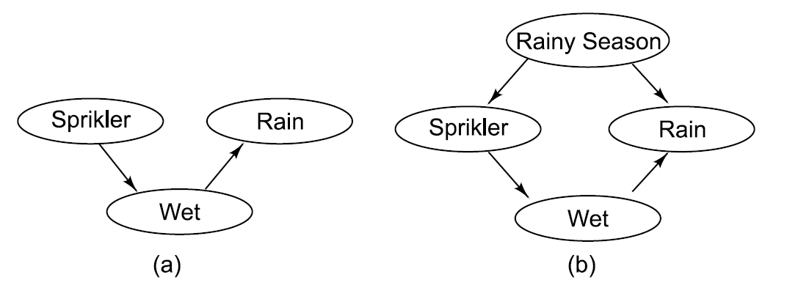
Bayesian Networks : Representing Causality Uniformly
There are two different ways that propositions can influence the likelihood of each other:
Propositions can influence the likelihood of their symptoms.
Observing a symptom affects the likelihood of all of its possible causes.

Slide 22
Conditional Probabilities for Bayesian Network

Slide 23
Bayesian Networks
Three algorithms are available for doing computations
A message-passing method.
A cliché triangular method.
Stochastic algorithms or Randomized algorithms.

Slide 24
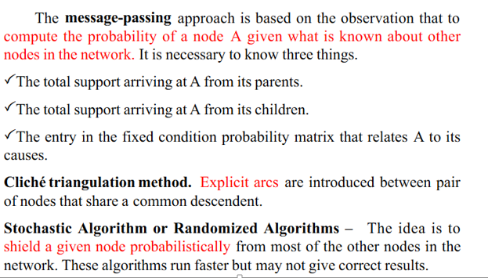
Bayesian Networks

Slide 25
Dempster -Shafer Theory
We consider the interval :
Plausibility (Pl) is defined to be :
Let the frame of discernment be an exhaustive, mutually exclusive set of hypothesis.
Let m be a probability density function.
We define the combination m₃ of m₁ and m₂ to be

Slide 26

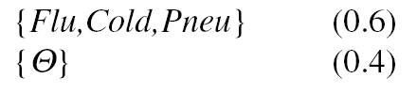
Dempster - Shafer Example
Let be :
All : allergy
Flu : flu
Cold : cold
Pneu : pneumonia
When we begin, with no information m is :
Suppose m₁ corresponds to our belief after observing fever.
Suppose m₂ corresponds to our belief after observing a runny nose.

Slide 27
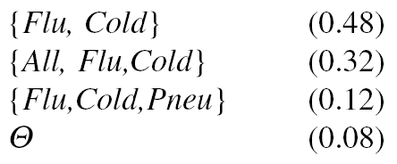
Dempster - Shafer Example (Cont’d)
Then we can combine m₁ and m₂ :
So we produce a new, combined m₃ :
Suppose m₄ corresponds to our belief after that the problem goes away on trips :

Slide 28
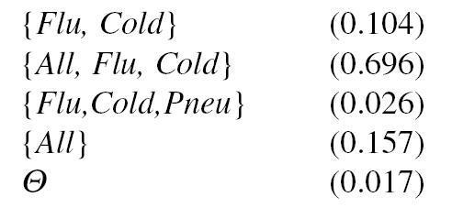
Dempster - Shafer Example (Cont’d)
Then we can combine m₁ and m₂ :
Normalizing to get rid of the belief of 0.54 associated with
gives m₅ :

Slide 29
Fuzzy Logic
Suppose we want to represent :
John is very tall.
Mary is slightly ill.
Sue and Linda are close friends.
Exceptions to the rule are nearly impossible.
Most Frenchmen are not very tall.

Slide 30
Fuzzy versus Conventional Set Membership

Slide 31
Summary
In this chapter we have shown that Bayesian statistics provide a good basis for reasoning under various kinds of uncertainty. We have also, though, talked about its weaknesses in complex real tasks, and so we have talked about ways in which it can be modified to work in practical domains. The thing that all of these modifications have in common is that they substitute, for the huge joint probability matrix that a pure Bayesian approach requires, a more structured representation of the facts that are relevant to a particular problem. They typically do this by combining probabilistic information with knowledge that is represented using one or more other representational mechanisms, such as rules or constraint networks. Comparing these approaches for use in a particular problem-solving program is not always straight forward, since they differ along several dimensions, for example:
• They provide different mechanisms for describing the ways in which propositions are not independent of each other.
• They provide different techniques for representing ignorance.
• They differ substantially in the ease with which systems that use them can be built and in the computational complexity that the resulting systems exhibit.
We have also presented fuzzy logic as an alternative for representing some kinds of uncertain knowledge. Although there remain many arguments about the relative overall merits of the Bayesian and the fuzzy approaches, there is some evidence that they may both be useful in capturing different kinds of information. As an example, consider the proposition
John was pretty sure that Mary was seriously ill.
Bayesian approaches naturally capture John’s degree of certainty, while fuzzy techniques ran describe the degree of Mary’s illness.
Throughout all of this discussion, it is important to keep in mind the fact that although we have been discussing techniques for representing knowledge, there is another perspective from which what we have really been doing is describing ways of representing lack of knowledge. In this sense, the techniques we have described in this chapter are fundamentally different from the ones we talked about earlier. For example, the truth values that we manipulate in a logical system characterize the formulas that we write; certainty measures, on the other hand, describe the exceptions — the facts that do not appear anywhere in the formulas that we have written.

